Slide 1
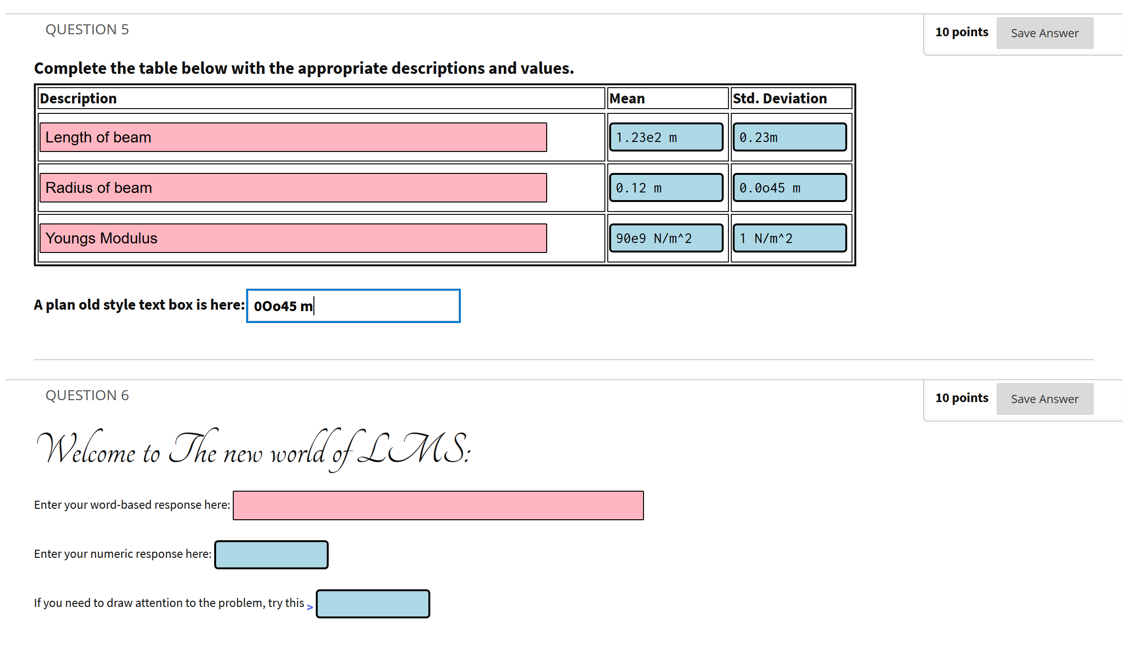
Uses Arial font
(pink background to indicate word based answers)
Note the use of Consolata font as this ensure that a slashed ZERO is used to educes confusion with an upper or lowers case letter O.
(light blue background to indicate word based answers)
Entry box to indicate words or sentences are require
Entry box to indicate numbers (possibly with units) are require

Slide 2
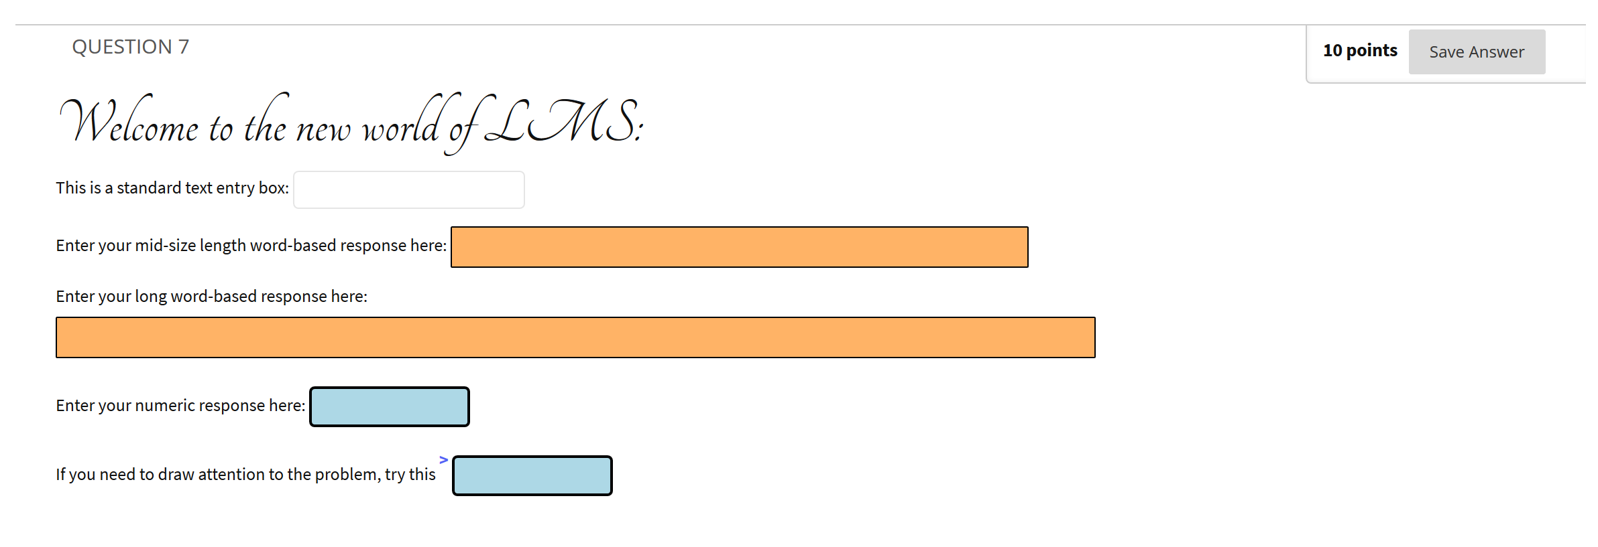
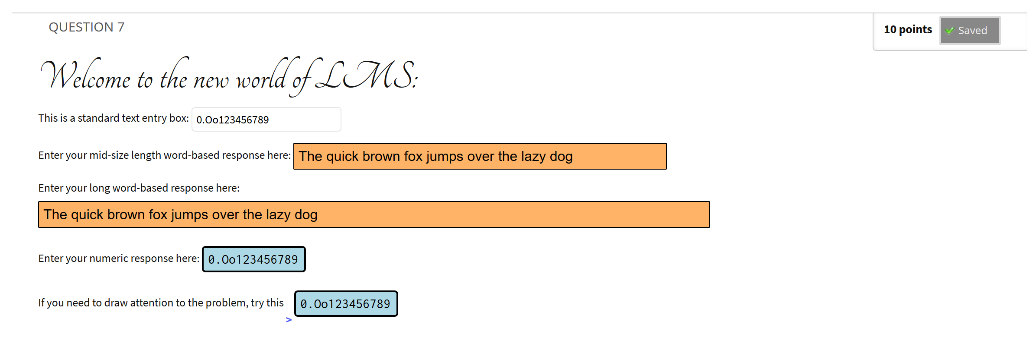
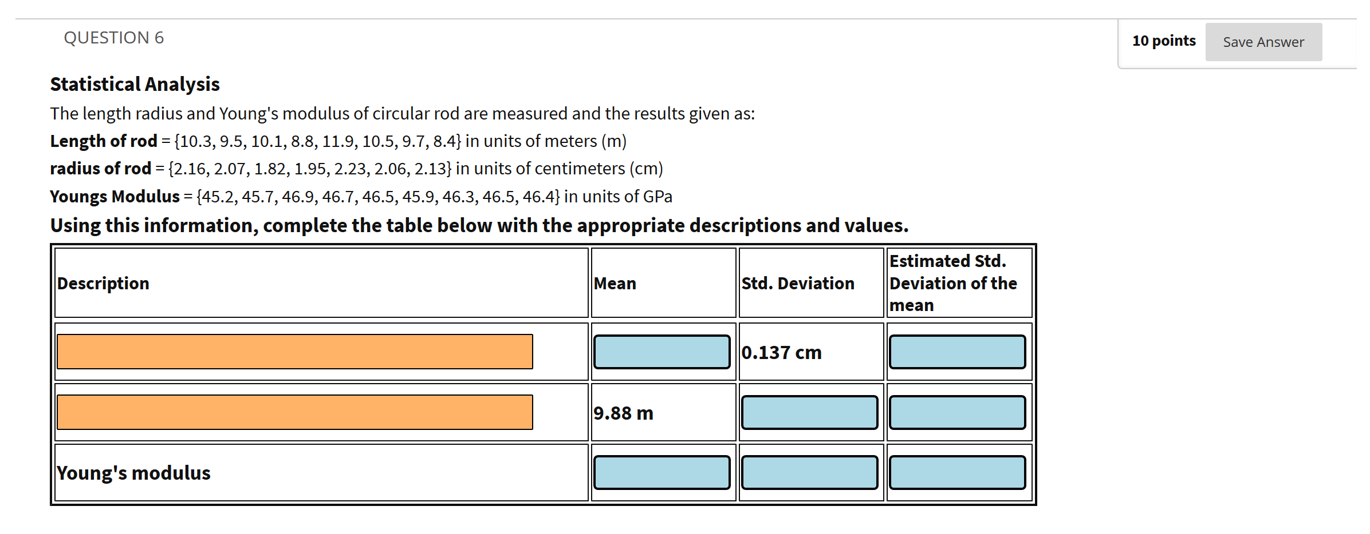
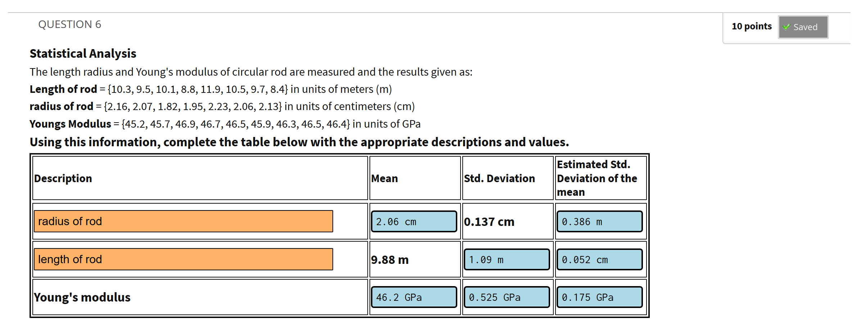
Uses Arial font
(orange background to indicate word based answers)
Instructions
Note the use of Consolata font as this ensure that a slashed ZERO is used to educes confusion with an upper or lowers case letter O.
(light blue background to indicate word based answers)
Where you see the entry box looking like this (pink), please enter one or more words
Where you see the entry box looking like this (light blue), please enter a number with unit where appropriate
Entry box to indicate words or sentences are require
Entry box to indicate numbers (possibly with units) are require

Slide 3
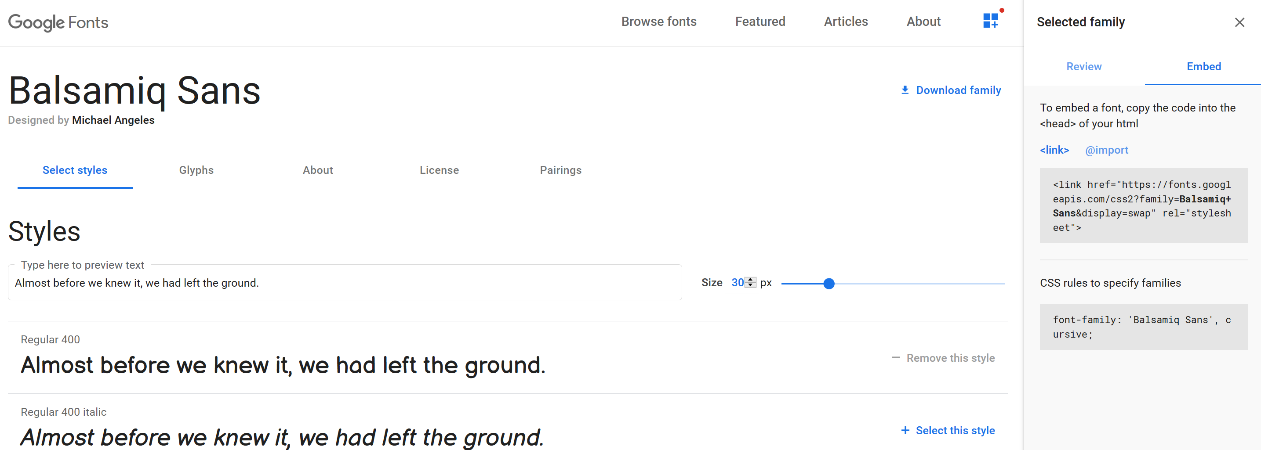
Goto https://fonts.google.com/
And select your font
Select Embed
b) Select the link to add to the top of the HTML Blackboard Question
c) Select the CSS to add to your <p> or <span> tags before the text to style

